Slide 1

COURSE: B.Sc.(PROGRAMME) IN ECONOMICS
PAPER NAME – MICROECONOMICS II
TOPIC – SCARCITY RENT, DIFFERENTIAL RENT AND QUASI-RENT
YEAR- THIRD SEMESTER-5 SESSION -2022-2023
DATE OF LECTURE: 26/08/2022
PREPARED BY
DR. KAMALIKA CHAKRABORTY
ASSISTANT PROFESSOR (DEPARTMENT OF ECONOMICS)
KHATRA ADIBASI MAHAVIDYALAYA, BANKURA, WEST BENGAL

Slide 2
RICARDIAN THEORY OF RENT
Ricardo defined rent as, “that portion of the produce of the earth which is paid to the landlord for the use of the original and indestructible powers of the soil.”
1. Rent of land arises due to the differences in the fertility or situation of the different plots of land. It arises owing to the original and indestructible powers of the soil.
2. Ricardo assumes the operation of the law of diminishing marginal returns in the case of cultivation of land. As the different plots of land differ in fertility, the produce from the inferior plots of land diminishes though the total cost of production in each plot of land is the same.
3. Ricardo looks at the supply of land from the standpoint of the society as a whole.
4. In the Ricardian theory it is assumed that land, being a gift of nature, has no supply price and no cost of prod

Slide 3
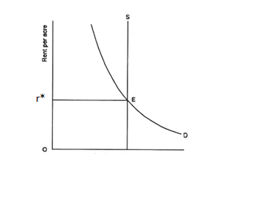
According to Ricardo rent arises for two main reasons:
(1) Scarcity of land as a factor and
(2) Differences in the fertility of the soil.
SCARCITY RENT
This rent arises due to the scarcity of homogenous land. This rent is, therefore, called scarcity rent.

Slide 4
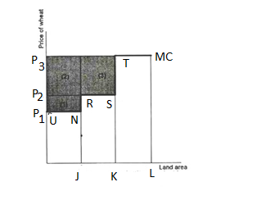
DIFFERENTIAL RENT
Differential rent arises when quality of plot varies across the land. If one plot is relatively more fertile than the other plot, the average cost of production will be lower in the first one. When price rises over the average minimum cost of production in less fertile land, a surplus will be generated in the more fertile land and this surplus is called differential rent.

Slide 5
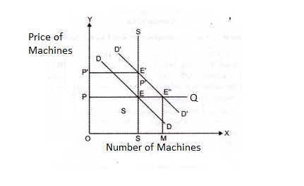
QUASI-RENT
The concept of Quasi-rent was developed by Prof. Alfred Marshall. According to him quasi-rent is a temporary gain which a factor of production earns due to temporary limitation in its supply.

Slide 6
THANK YOU

